Slide 1
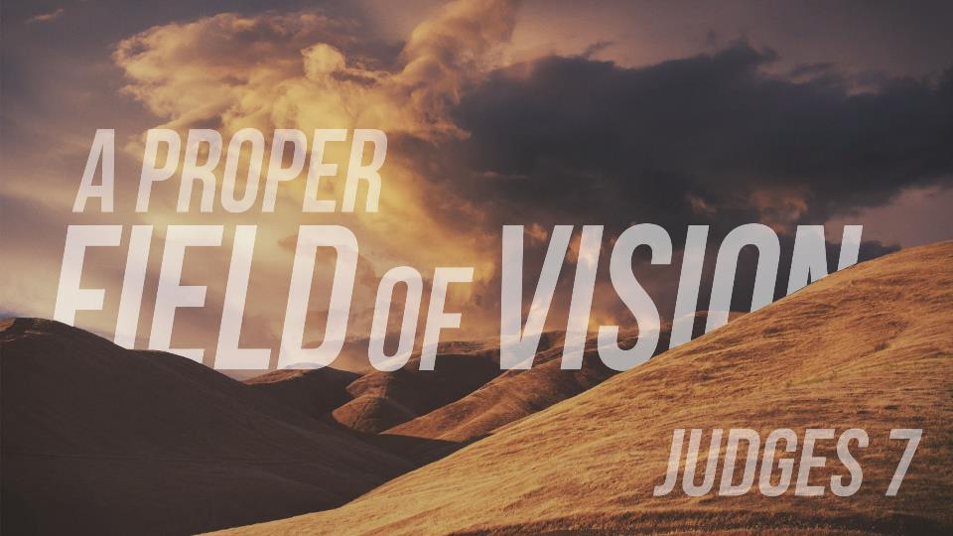

Slide 2
Judges 6:6 And the children of Israel did evil in the sight of the Lord: and the Lord delivered them into the hand of Midian seven years. 2 And the hand of Midian prevailed against Israel: and because of the Midianites the children of Israel made them the dens which are in the mountains, and caves, and strong holds.

Slide 3
...verse 14 And the Lord looked upon him, and said, Go in this thy might, and thou shalt save Israel from the hand of the Midianites: have not I sent thee?

Slide 4
5 And it came to pass the same night, that the Lord said unto him, Take thy father's young bullock, even the second bullock of seven years old, and throw down the altar of Baal that thy father hath, and cut down the grove that is by it:26 And build an altar unto the Lord thy God upon the top of this rock, in the ordered place, and take the second bullock, and offer a burnt sacrifice with the wood of the grove which thou shalt cut down.

Slide 5
KEY POINT #1
If the worship within the congregation is false, the mission will be in vain.

Slide 6
33 Then all the Midianites and the Amalekites and the children of the east were gathered together, and went over, and pitched in the valley of Jezreel. 34 But the Spirit of the Lord came upon Gideon, and he blew a trumpet; and Abiezer was gathered after him. 35 And he sent messengers throughout all Manasseh; who also was gathered after him: and he sent messengers unto Asher, and unto Zebulun, and unto Naphtali; and they came up to meet them.

Slide 7
Credit to Whom Credit is Due
7:1 Then Jerubbaal, who is Gideon, and all the people that were with him, rose up early, and pitched beside the well of Harod: so that the host of the Midianites were on the north side of them, by the hill of Moreh, in the valley. 2 And the Lord said unto Gideon, The people that are with thee are too many for me to give the Midianites into their hands, lest Israel vaunt themselves against me, saying, Mine own hand hath saved me.

Slide 8
Credit to Whom Credit is Due
1 Samuel 14:6 And Jonathan said to the young man that bare his armour, Come, and let us go over unto the garrison of these uncircumcised: it may be that the LORD will work for us: for there is no restraint to the LORD to save by many or by few. 13 And Jonathan climbed up upon his hands and upon his feet, and his armourbearer after him: and they fell before Jonathan; and his armourbearer slew after him. 14 And that first slaughter, which Jonathan and his armourbearer made, was about twenty men, within as it were an half acre of land, which a yoke of oxen might plow. 15 And there was trembling in the host, in the field, and among all the people: the garrison, and the spoilers, they also trembled, and the earth quaked: so it was a very great trembling.

Slide 9
KEY POINT #2
When the odds are against us and yet we prevail, God gets maximum glory

Slide 10
The Filter of Fear
3 Now therefore go to, proclaim in the ears of the people, saying, Whosoever is fearful and afraid, let him return and depart early from mount Gilead. And there returned of the people twenty and two thousand; and there remained ten thousand.

Slide 11
KEY POINT #3
People turn back when they don’t reckon that dying for God is greater than living for self

Slide 12
Philippians 3:7 But what things were gain to me, those I counted loss for Christ. 8 Yea doubtless, and I count all things but loss for the excellency of the knowledge of Christ Jesus my Lord: for whom I have suffered the loss of all things, and do count them but dung, that I may win Christ, 9 And be found in him, not having mine own righteousness, which is of the law, but that which is through the faith of Christ, the righteousness which is of God by faith: 10 That I may know him, and the power of his resurrection, and the fellowship of his sufferings, being made conformable unto his death; 11 If by any means I might attain unto the resurrection of the dead.

Slide 13
Psalm 44:8 In God we boast all the day long, and praise thy name for ever. Selah.
9 But thou hast cast off, and put us to shame; and goest not forth with our armies.
10 Thou makest us to turn back from the enemy: and they which hate us spoil for themselves.
11 Thou hast given us like sheep appointed for meat; and hast scattered us among the heathen.

Slide 14
The Sifting of Personal Priority
4 And the Lord said unto Gideon, The people are yet too many; bring them down unto the water, and I will try them for thee there:

Slide 15
The Sifting of Personal Priority
4 And the Lord said unto Gideon, The people are yet too many; bring them down unto the water, and I will try them for thee there:

Slide 16
The Sifting of Personal Priority
4 And the Lord said unto Gideon, The people are yet too many; bring them down unto the water, and I will try them for thee there:

Slide 17
KEY POINT #4
Trials always distinguish the soldier from the spectator

Slide 18
Romans 8:35 Who shall separate us from the love of Christ? shall tribulation, or distress, or persecution, or famine, or nakedness, or peril, or sword? 36 As it is written, For thy sake we are killed all the day long; we are accounted as sheep for the slaughter. 37 Nay, in all these things we are more than conquerors through him that loved us.

Slide 19
2 Corinthians 12:9 And he said unto me, My grace is sufficient for thee: for my strength is made perfect in weakness. Most gladly therefore will I rather glory in my infirmities, that the power of Christ may rest upon me. 10 Therefore I take pleasure in infirmities, in reproaches, in necessities, in persecutions, in distresses for Christ's sake: for when I am weak, then am I strong.

Slide 20
A Proper Field of Vision
4 And the Lord said unto Gideon, The people are yet too many; bring them down unto the water, and I will try them for thee there: and it shall be, that of whom I say unto thee, This shall go with thee, the same shall go with thee; and of whomsoever I say unto thee, This shall not go with thee, the same shall not go.5 So he brought down the people unto the water: and the Lord said unto Gideon, Every one that lappeth of the water with his tongue, as a dog lappeth, him shalt thou set by himself; likewise every one that boweth down upon his knees to drink.

Slide 21
6 And the number of them that lapped, putting their hand to their mouth, were three hundred men: but all the rest of the people bowed down upon their knees to drink water. 7 And the Lord said unto Gideon, By the three hundred men that lapped will I save you, and deliver the Midianites into thine hand: and let all the other people go every man unto his place.

Slide 22
A Proper Field of Vision
Careless The first soldier is so thirsty that he gets down on his knees and shoves his head in the water.

Slide 23
A Proper Field of Vision
Careless The first soldier is so thirsty that they get down on their knees and they shove their heads in the water.
Circumspect This second soldier has the appetite for God’s word but also the eyes for the mission field.

Slide 24
John 4:35 Say not ye, There are yet four months, and then cometh harvest? behold, I say unto you, Lift up your eyes, and look on the fields; for they are white already to harvest.

Slide 25
KEY POINT #5
God is looking for Christians who can attend to personal need without neglecting evangelism and discipleship.

Slide 26
2 Tim 4:4 I charge thee therefore before God, and the Lord Jesus Christ, who shall judge the quick and the dead at his appearing and his kingdom; 2 Preach the word; be instant in season, out of season; reprove, rebuke, exhort with all long suffering and doctrine.3 For the time will come when they will not endure sound doctrine; but after their own lusts shall they heap to themselves teachers, having itching ears;4 And they shall turn away their ears from the truth, and shall be turned unto fables.5 But watch thou in all things, endure afflictions, do the work of an evangelist, make full proof of thy ministry.

Slide 27
What kind of Christian are you?
Do you have eyes to see and prioritize the mission field?

